Slide 1
GEOMETRIC & COMBINATORIAL DUAL

Slide 2
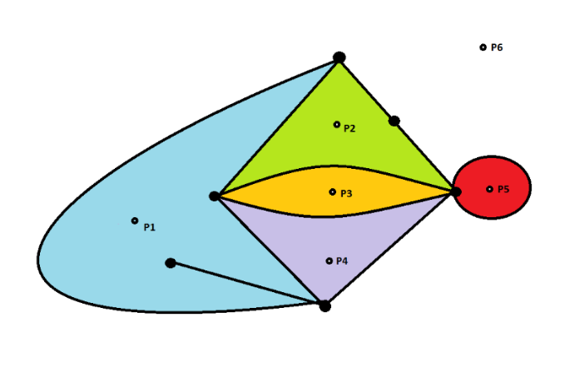
A
E
D
B
F
C

Slide 3
How to construct a dual ?
If two regions Fi and Fj are adjacent (i.e have a common edge), draw a line joining points Pi and Pj that intersects the common edge between Fi and Fj exactly once.
If there is more than one edge common between Fi and Fj, draw one line between points Pi and Pj for each of the common edges.
For an edge e lying entirely in one region, say Fk, draw a self-loop at point Pk, intersecting e exactly once.

Slide 4
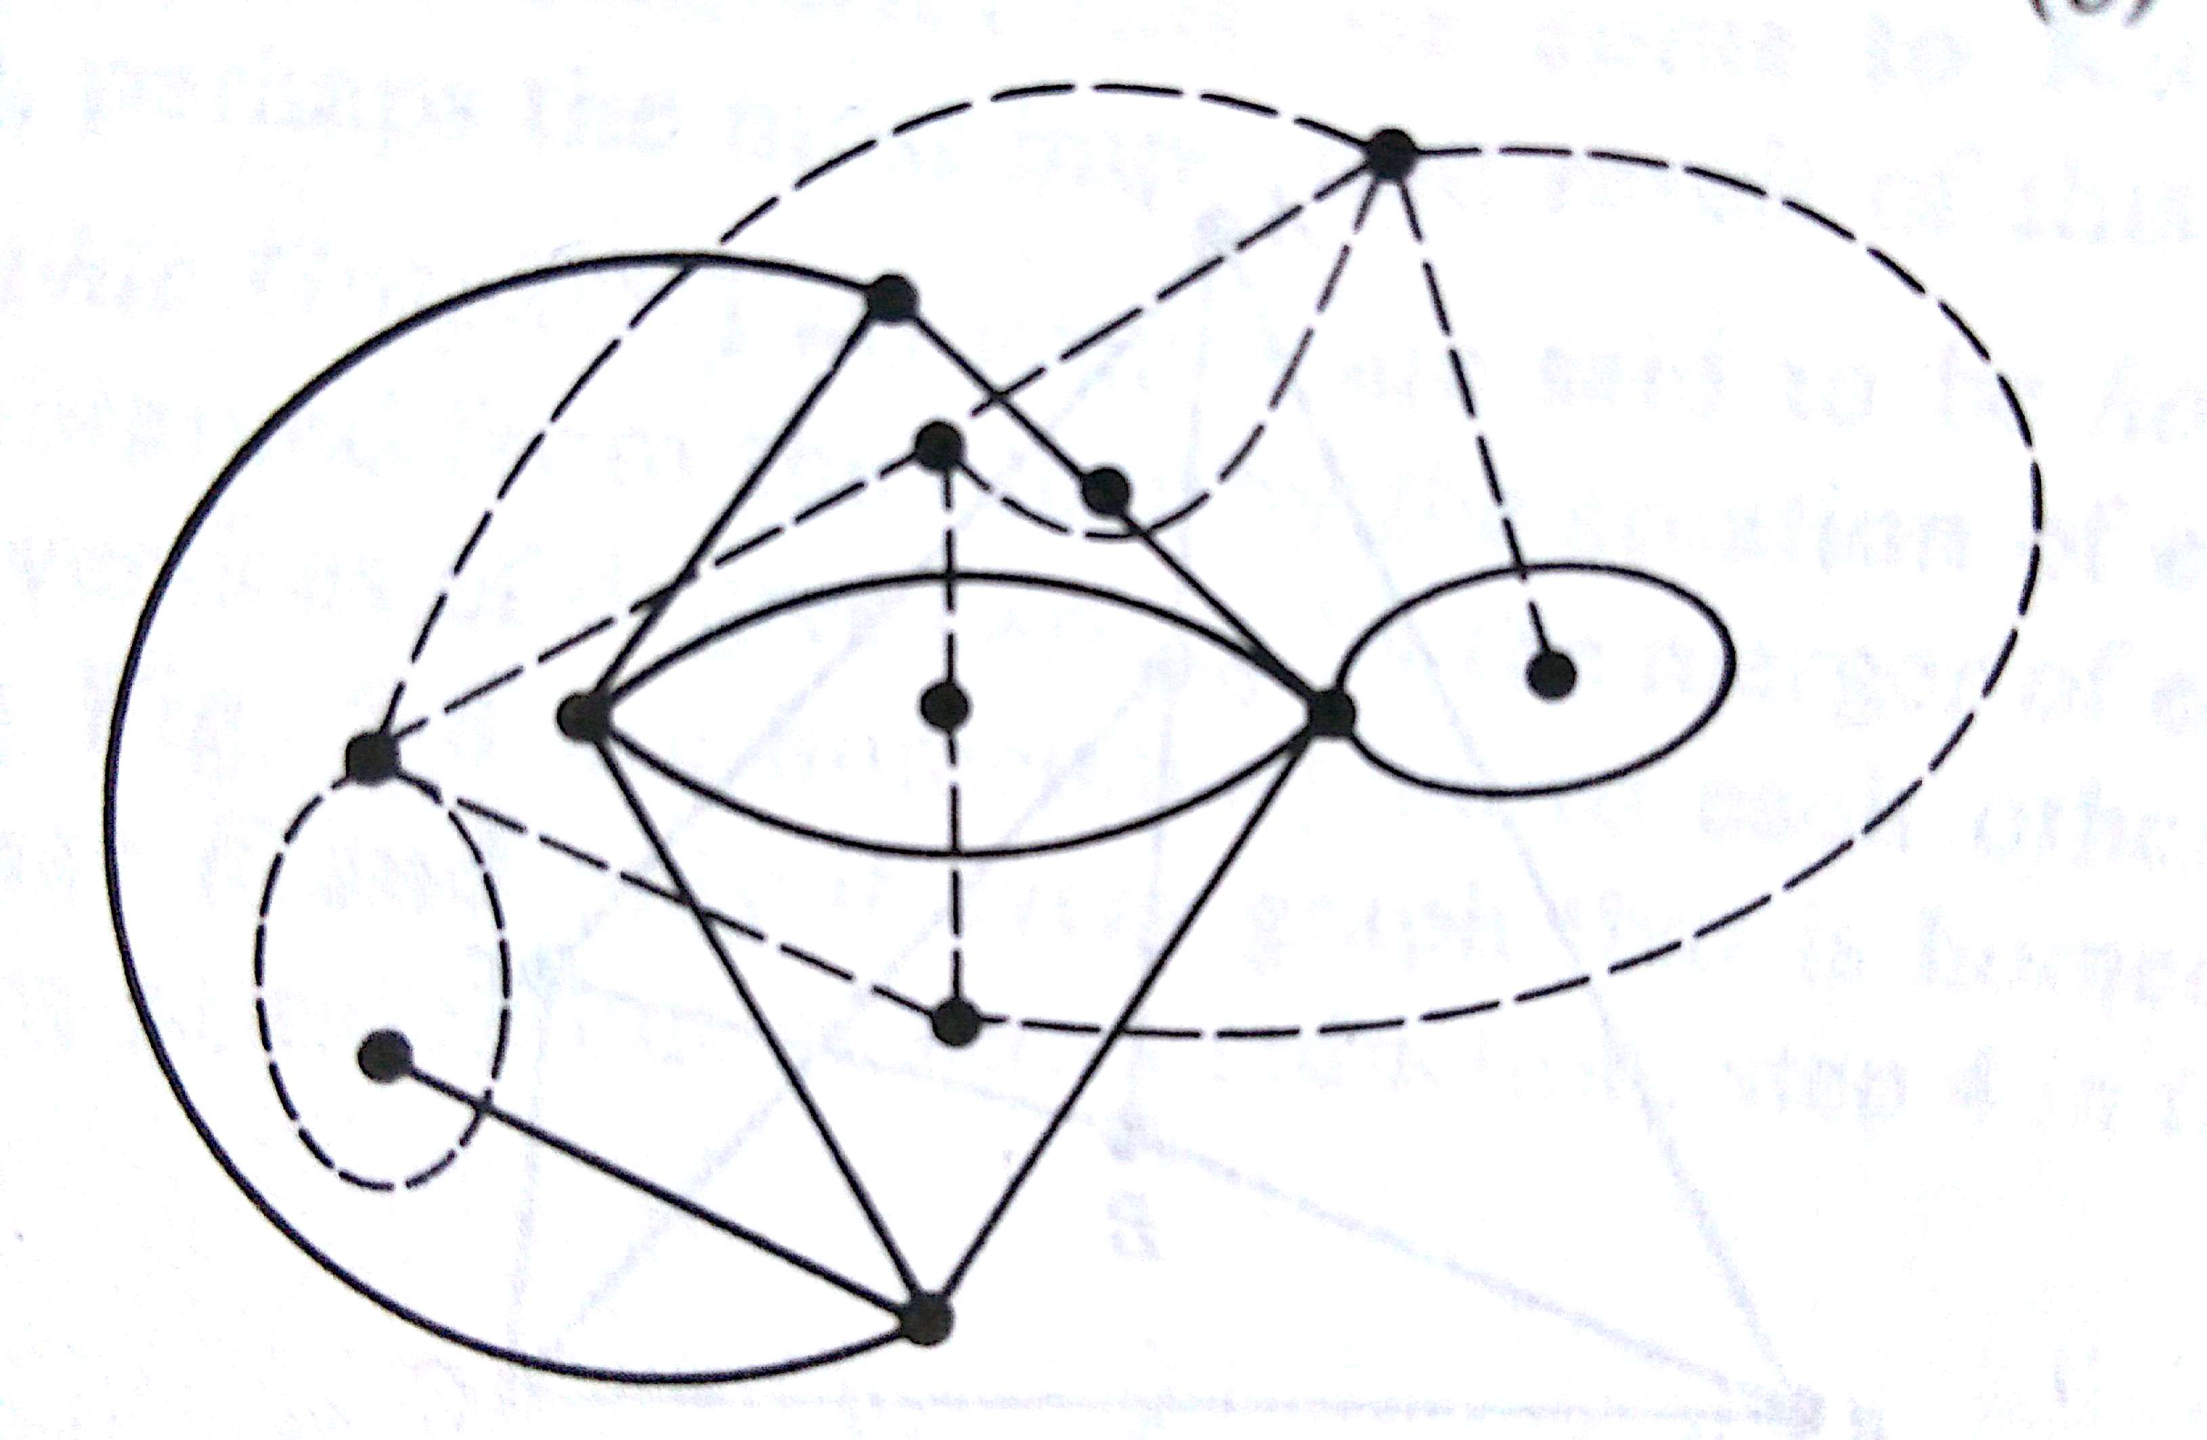

Slide 5
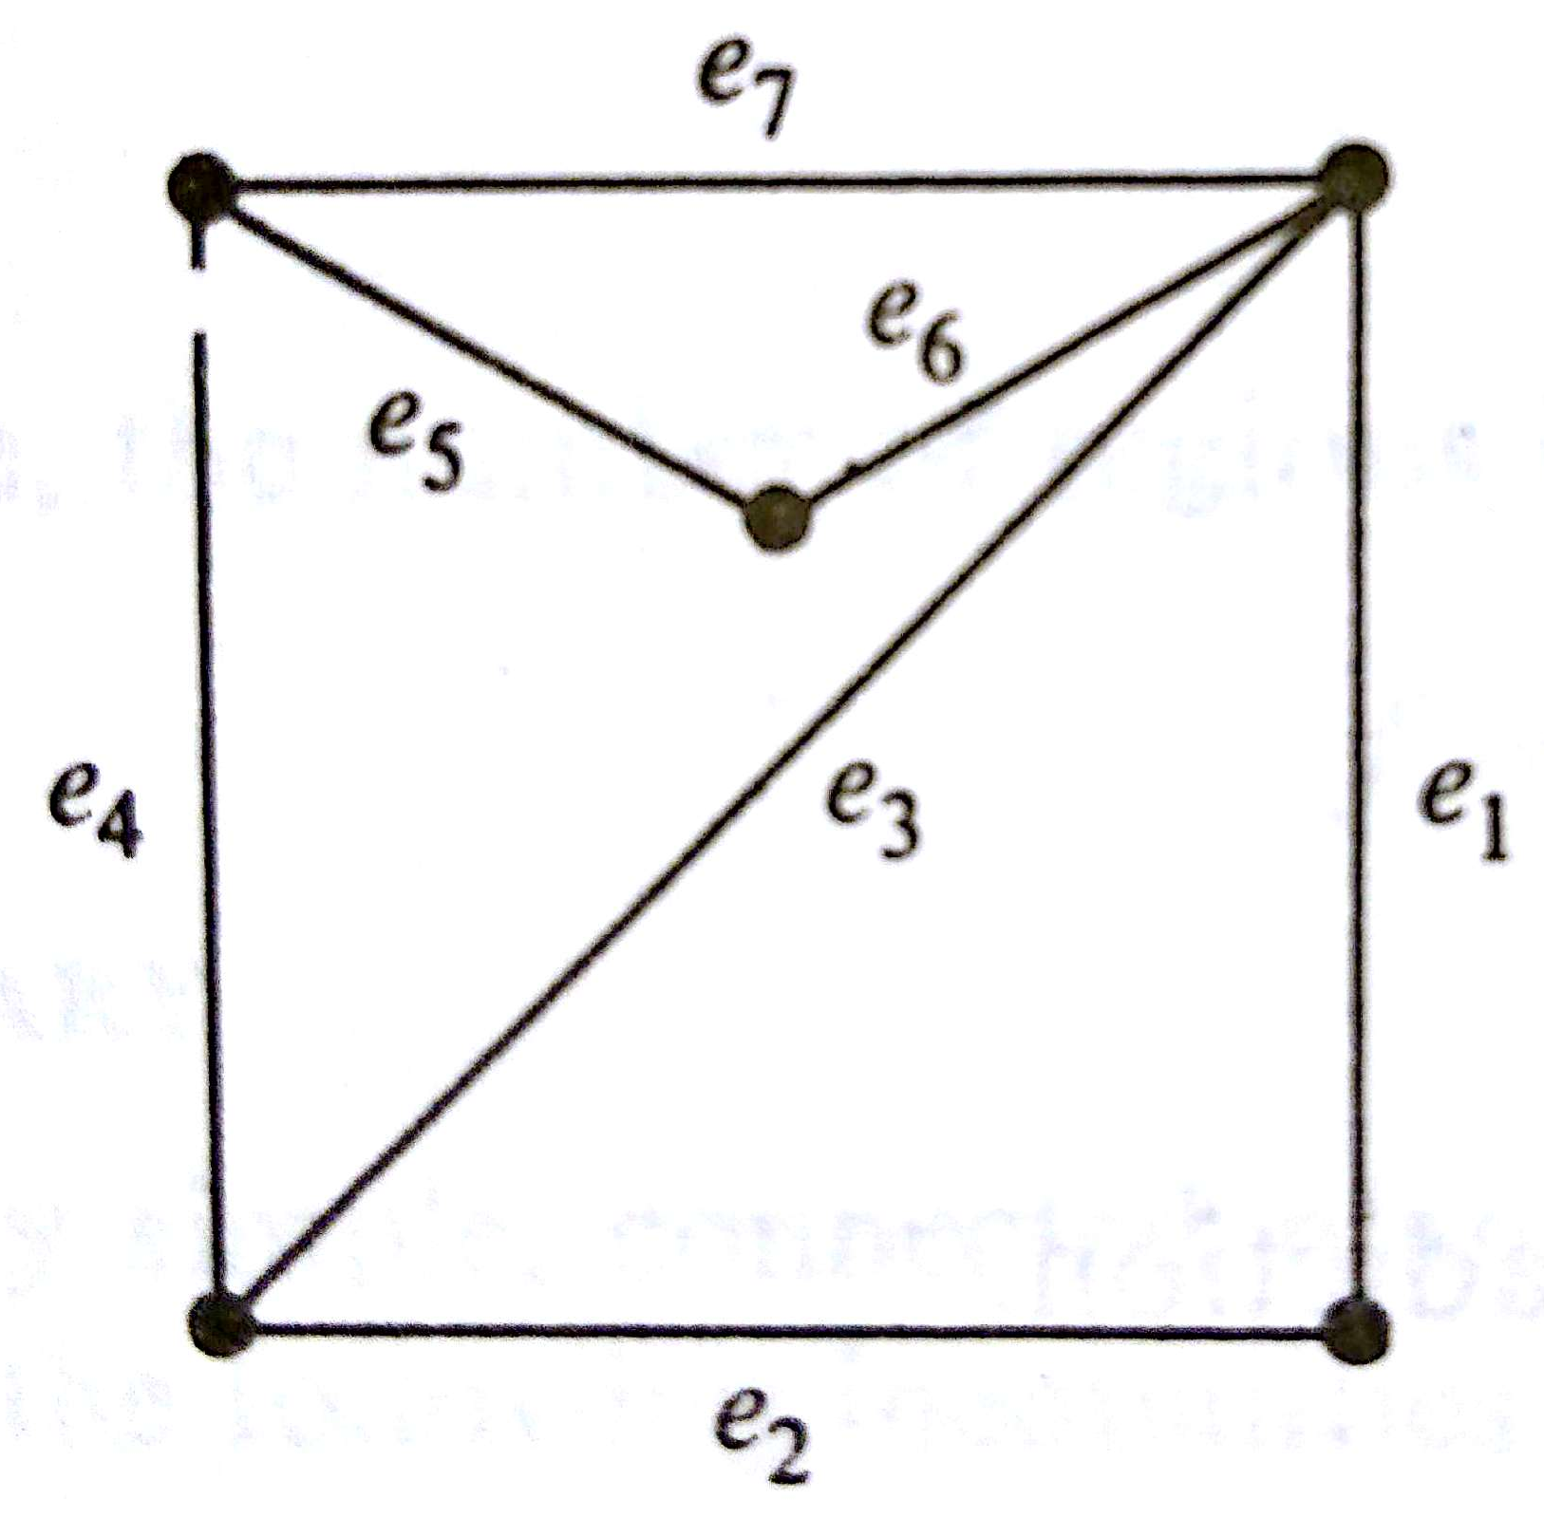
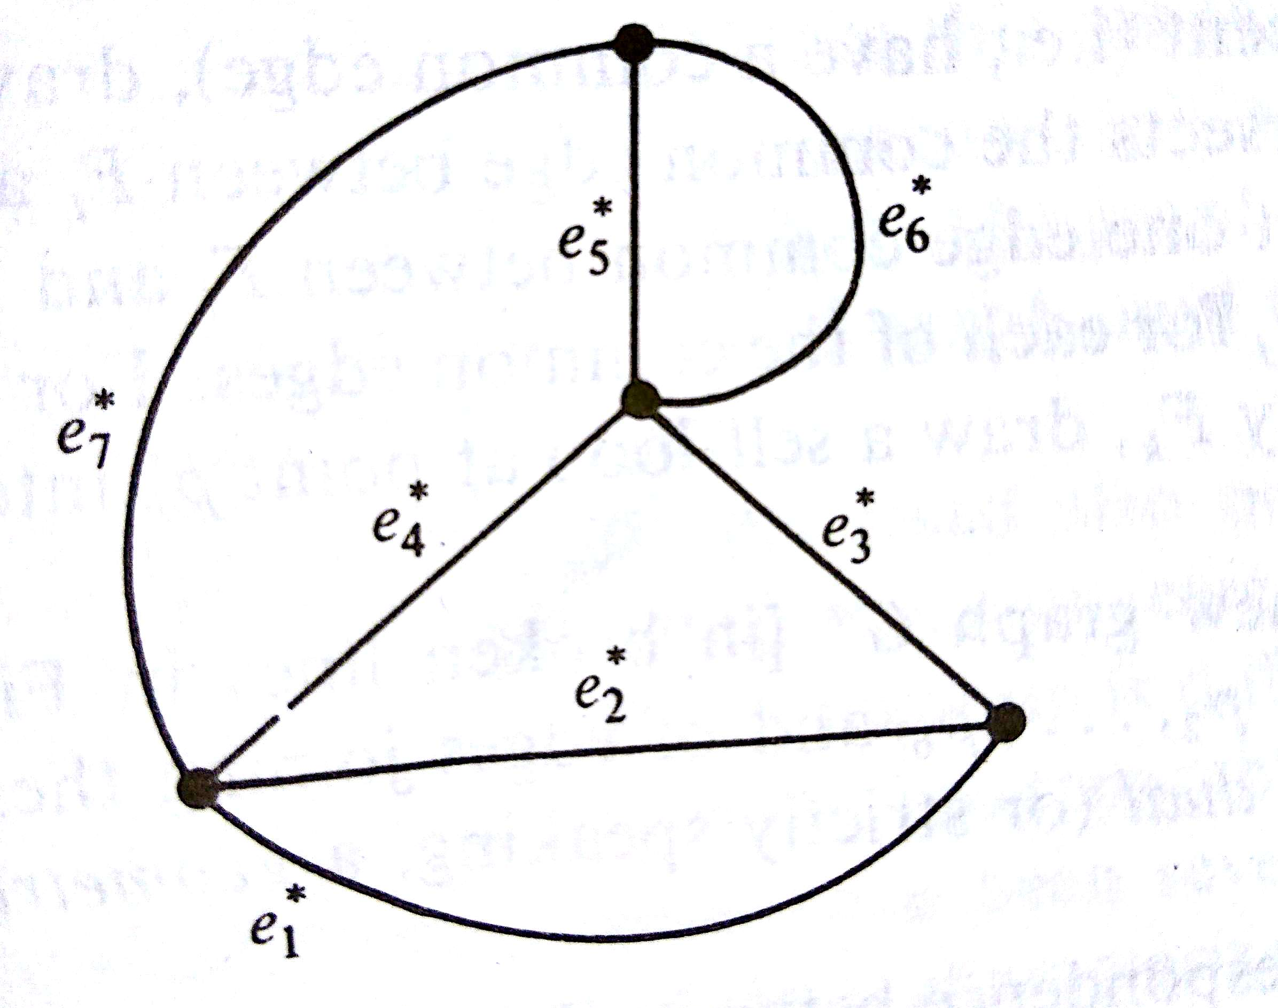
Theorem: A necessary and sufficient condition for two planar graphs G1 and G2 to be duals of each other is as follows: There is a one-to-one correspondence between the edges in G1 and the edges in G2 such that a set of edges in G1 forms a circuit if and only if the corresponding set in G2 forms a cut-set.

Slide 6
Theorem: A graph has a dual if and only if it is planar

Slide 7
Thank you…….

